Slide 1
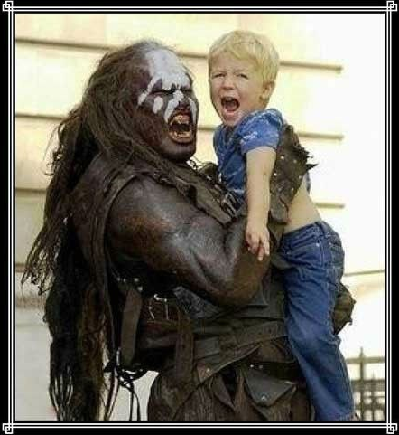

Crypto CrEche
A Blockchain-Based Solution for Childcare

Slide 2
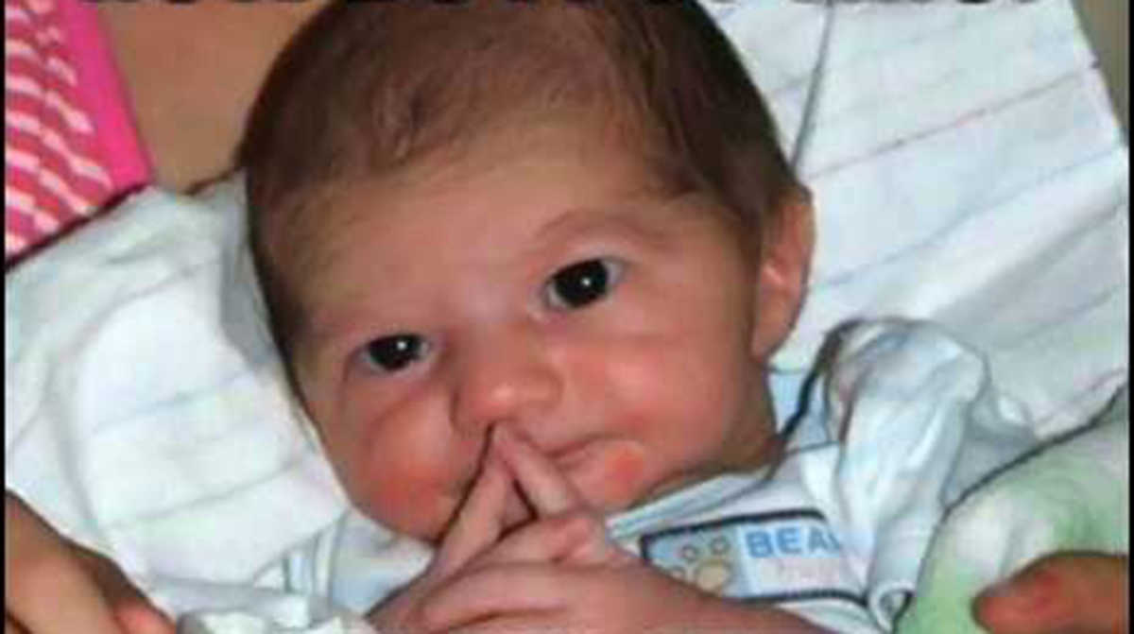
Why Childcare?
Highly trust based
Requires referrals and validation of referrals
Involves P2P transfer of value

Slide 3

Why Crypto?
Trustless system
Transaction history and digital identity validated on chain
Simultaneous transfer of value and validation of transfer

Slide 4
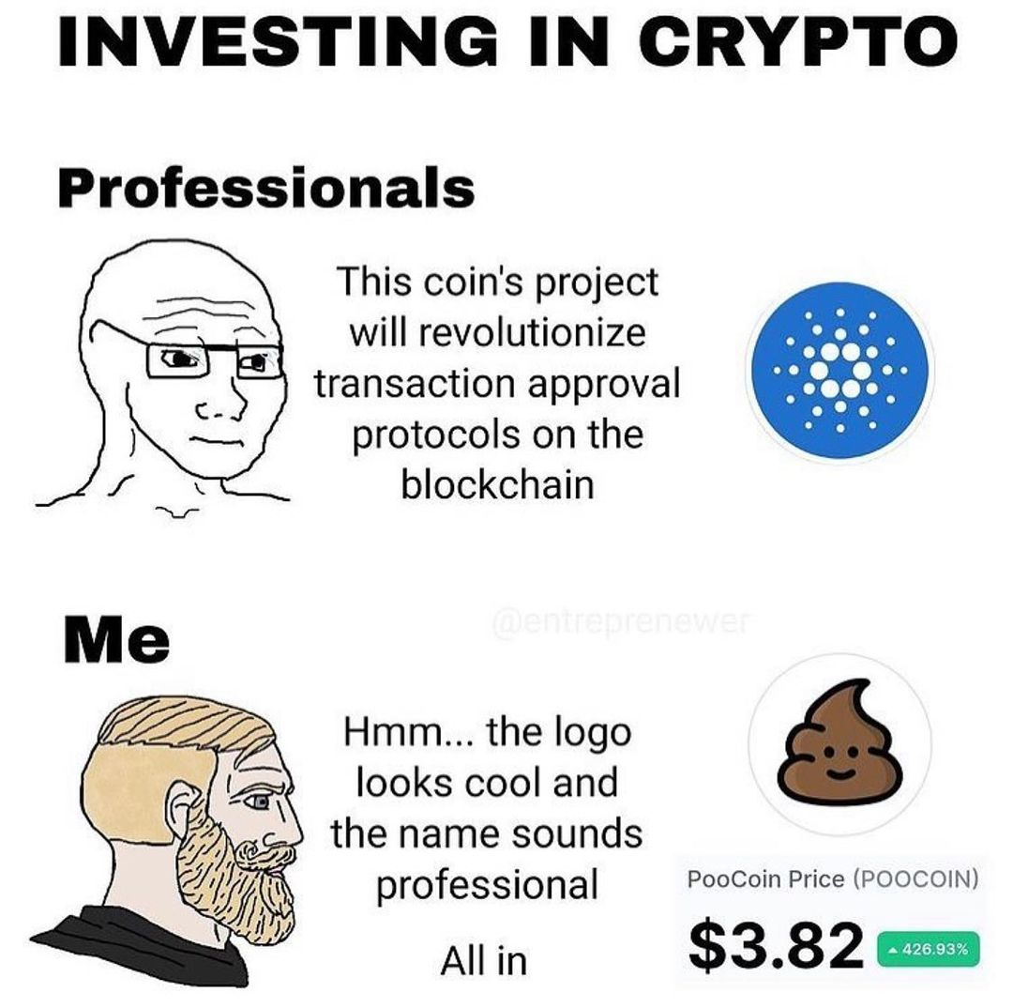
Ethos
BabyCoin
ERC-20 Utility Token
Does not translate to monetary value
Only has value in the community
Community/Neighborhood retains value
Incentivizes P2P value transfer within a community

Slide 5

How does it work?
A set number of tokens are allotted to the minter, in this case the community wallet address
Minter transfers equal numbers of tokens to members of the community
Members of the community exchange tokens for babysitting
Job Listings are stored on chain and are viewable by members of the community
Parent A can choose to engage in a Job Listing submitted by Parent B
Parent B sends tokens to Parent A

Slide 6
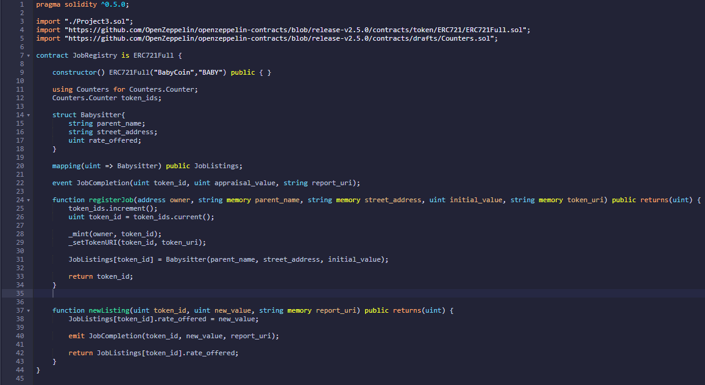
Job Listings Contract

Slide 7
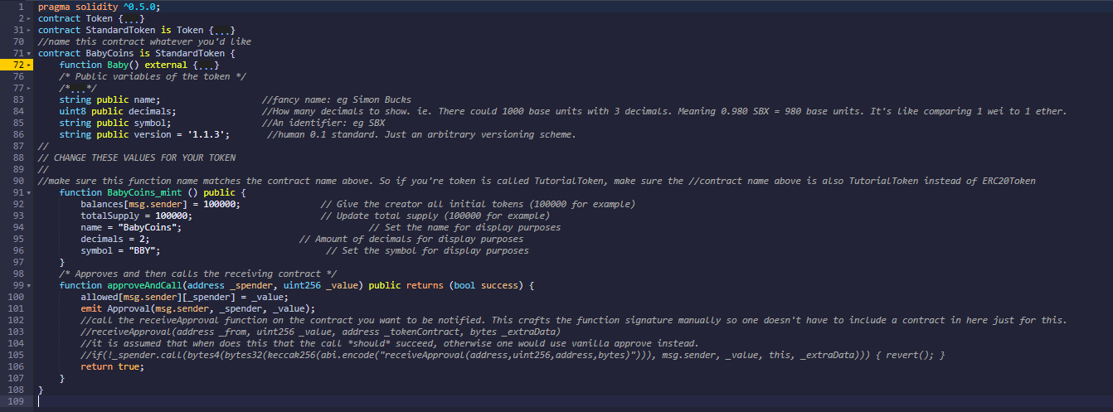
Token Mint and Distribution

Slide 8
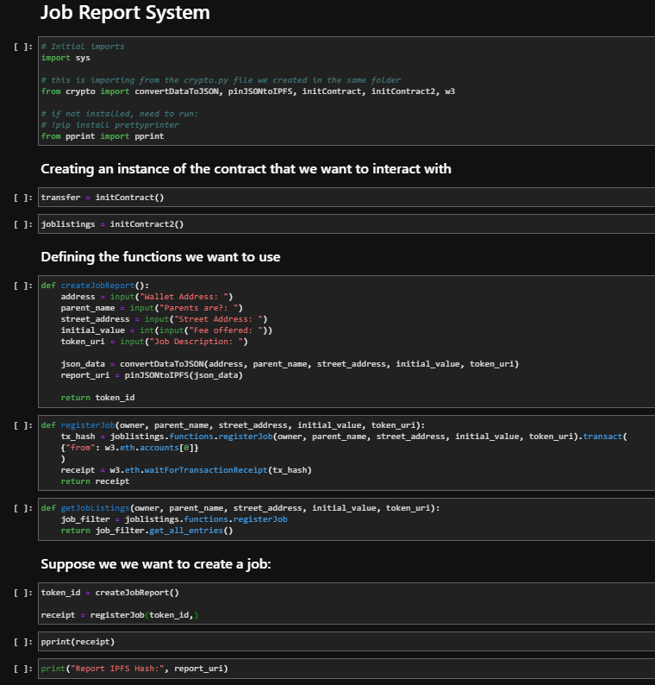
Python Integration

Slide 9

DEMO

Slide 10
Upscaling Use-Case
Upscaling the use-case for exchange of value for more goods and services
Incentivizes retention of value within a community
Disincentivizes outflow of value from a community

Slide 11
Tokenomics Implications
Requires defined rate of mint and distribution
Requires defined permissions for minting, distributing and transferring tokens
Token tax for infrequent use
Token tariff on hiring labor outside of immediate vicinity

Slide 12

Q&A

Slide 13

Thank you

